Slide 1

Aircraft Recommendations
Task: Executive Summary
Student: Kalaikkovan Vasanthakumar
Class: DSC-640

Slide 2
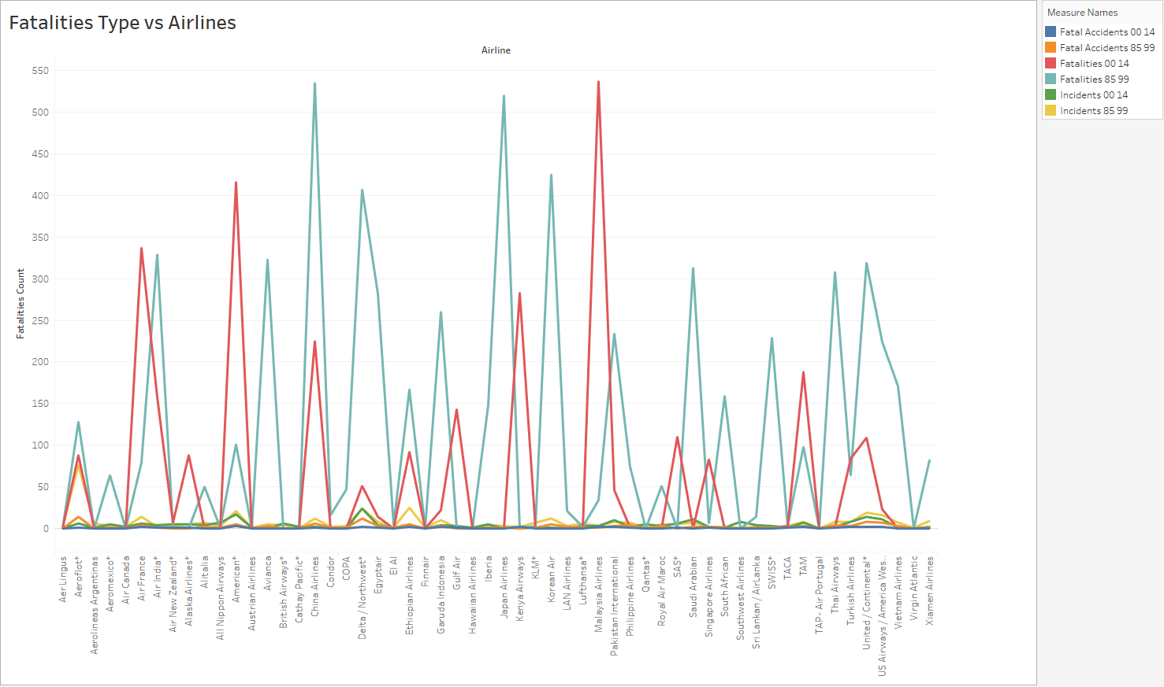

Slide 3
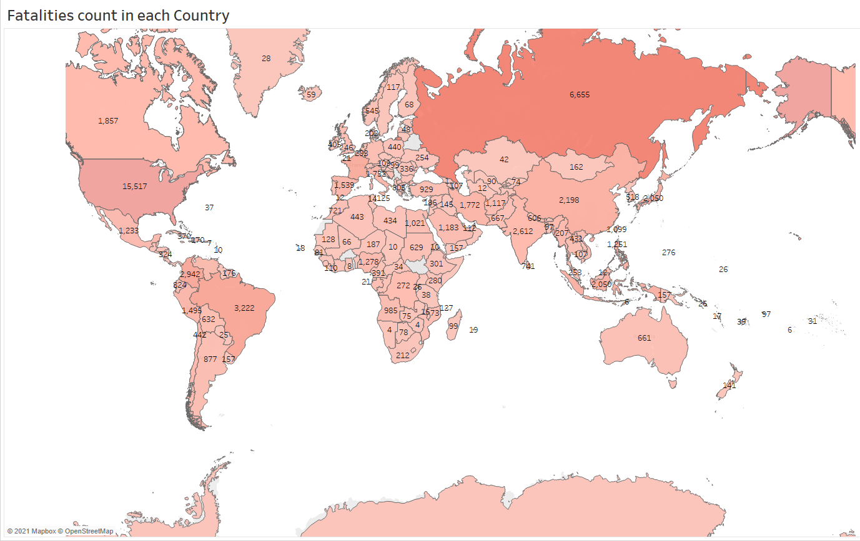

Slide 4
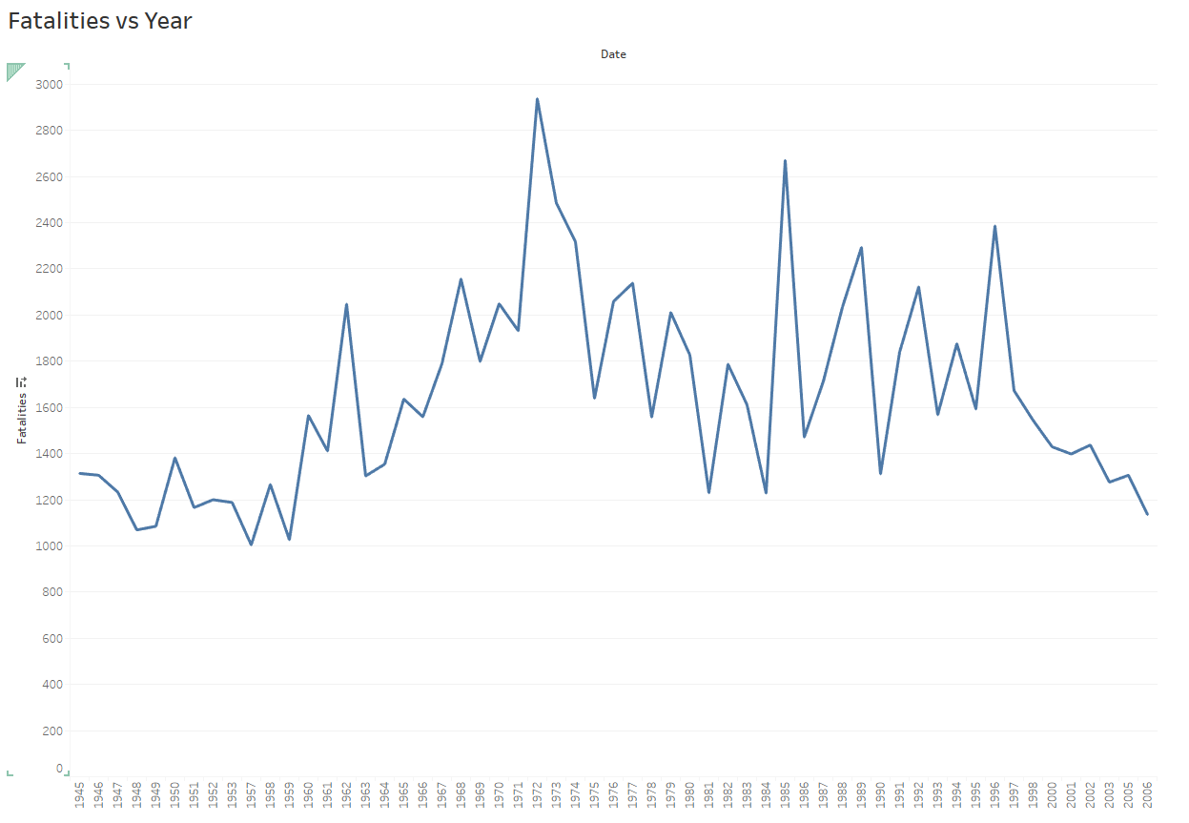

Slide 5
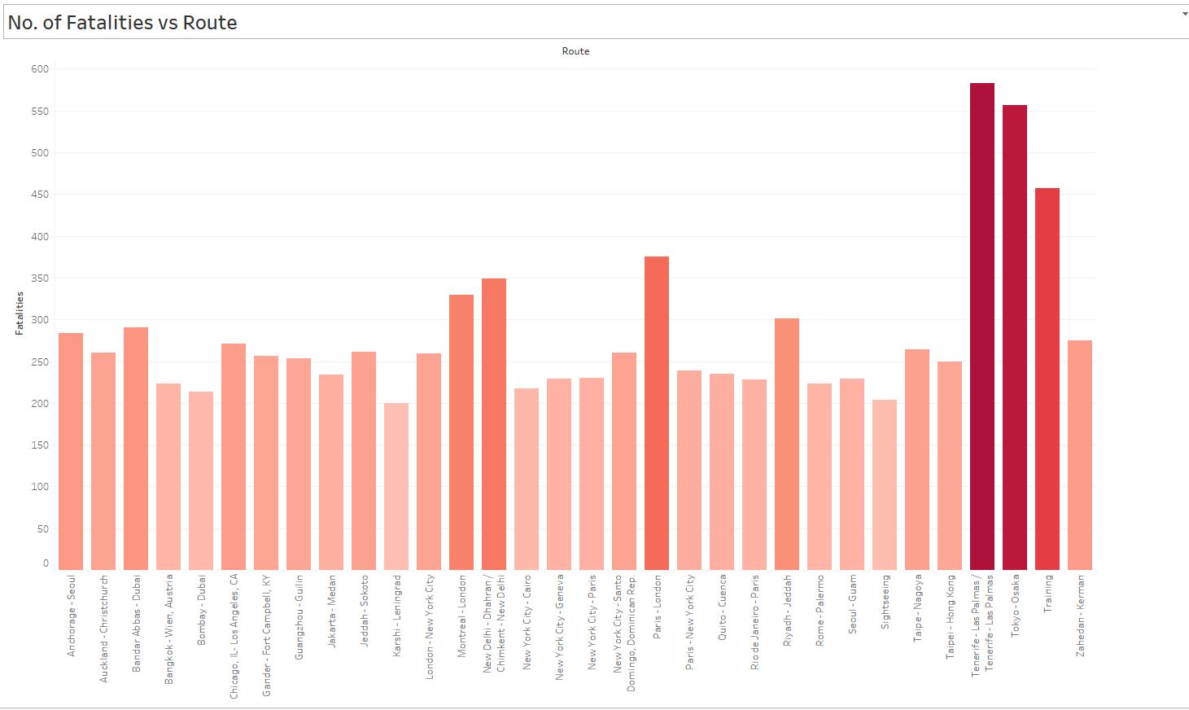

Slide 6
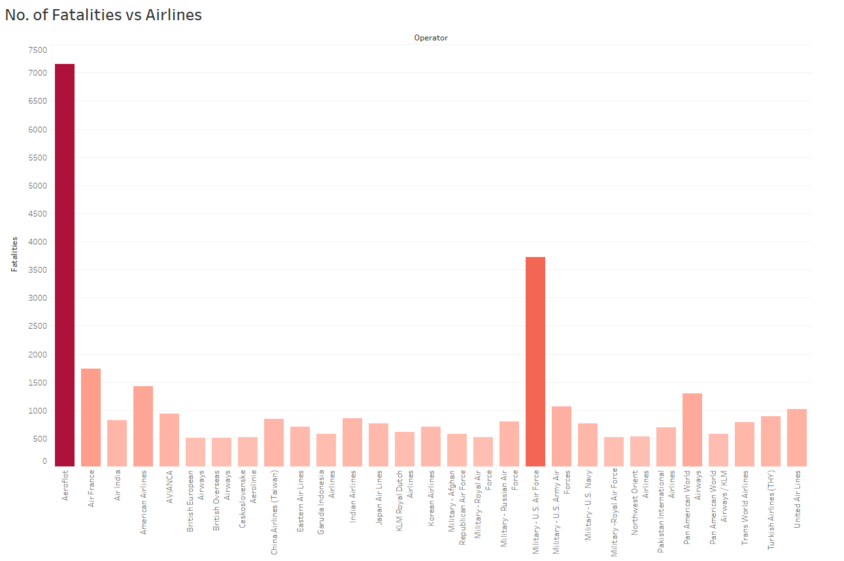

Slide 7
